Slide 1
Design and Analysis of Algorithms
Floyd Warshall Algorithm
Dr. Ashish Sharma
David Luebke <number> 11/07/26

Slide 2
Floyd Warshall Algorithm-
Floyd Warshall Algorithm is a famous algorithm.
It is used to solve All Pairs Shortest Path Problem.
It computes the shortest path between every pair of vertices of the given graph.
Floyd Warshall Algorithm is an example of dynamic programming approach.
David Luebke <number> 11/07/26

Slide 3
Floyd Warshall Algorithm-
Advantages-
It is extremely simple.
It is easy to implement.
David Luebke <number> 11/07/26

Slide 4
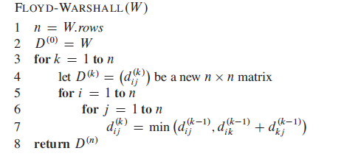
Floyd Warshall Algorithm-
David Luebke <number> 11/07/26

Slide 5
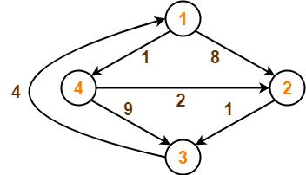
Example
David Luebke <number> 11/07/26

Slide 6
Step-01:
Remove all the self loops and parallel edges (keeping the lowest weight edge) from the graph.
In the given graph, there are neither self edges nor parallel edges.
David Luebke <number> 11/07/26

Slide 7
Step-02:
Write the initial distance matrix.
It represents the distance between every pair of vertices in the form of given weights.
For diagonal elements (representing self-loops), distance value = 0.
For vertices having a direct edge between them, distance value = weight of that edge.
For vertices having no direct edge between them, distance value = ∞.
David Luebke <number> 11/07/26

Slide 8
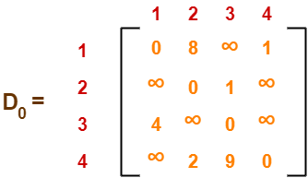
Initial distance matrix for the given graph is-
David Luebke <number> 11/07/26

Slide 9
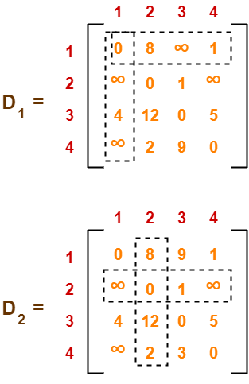
Step-03:
Using Floyd Warshall Algorithm, write the following 4 matrices-
David Luebke <number> 11/07/26

Slide 10
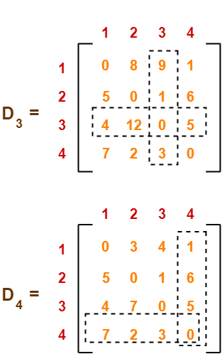
Cont…
David Luebke <number> 11/07/26

Slide 11
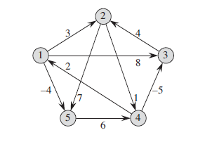
Exercise
David Luebke <number> 11/07/26

